Slide 1


Machine Learning
Hackathon
Team Name - MiLk
Team Leader Name – Samyak Deshpande
Team Leader Email Address - 112115138@cse.iiitp.ac.in

Slide 2
Brief Description of the Problem at hand:
The ad server logs contain valuable information that can be used to build a model that can accurately predict whether a user is an HCP and its specialization id/taxonomy. The input data includes browser details, IP addresses, geographic locations, search patterns, site urls, and other relevant data. The output of the model should be a file that contains two parameters: whether the user is an HCP and its specialization id/taxonomy. The input data also includes some rows where the taxonomy/specialization is not identified, and some rows where there is no information about HCP. The model should be able to handle these cases appropriately.

Slide 3
Solution proposed and description:
We used a bag-of-words approach to vectorize the keywords in the ad server logs. This means that we created a vector for each keyword, where the value of each element in the vector represented the number of times that keyword appeared in the log. We then applied a support vector machine (SVM) classifier to the keywords and the IS_HCP column. The SVM classifier is a machine learning algorithm that can be used to classify data into two or more categories. In this case, the two categories were whether the user was an HCP and whether the user's taxonomy/specialization was identified.

Slide 4
Approach:
We observed that the IP address was quite common in the dataset. To reduce the amount of data, we kept only one copy of those records whose IP addresses were the same and deleted all the others. This significantly reduced the amount of data, while still preserving the most important information. We chose to use this approach because it is a simple and effective way to classify data that contains keywords. The bag-of-words approach is a well-known and well-understood technique, and the SVM classifier is a powerful machine learning algorithm that can be used to classify data with high accuracy.

Slide 5
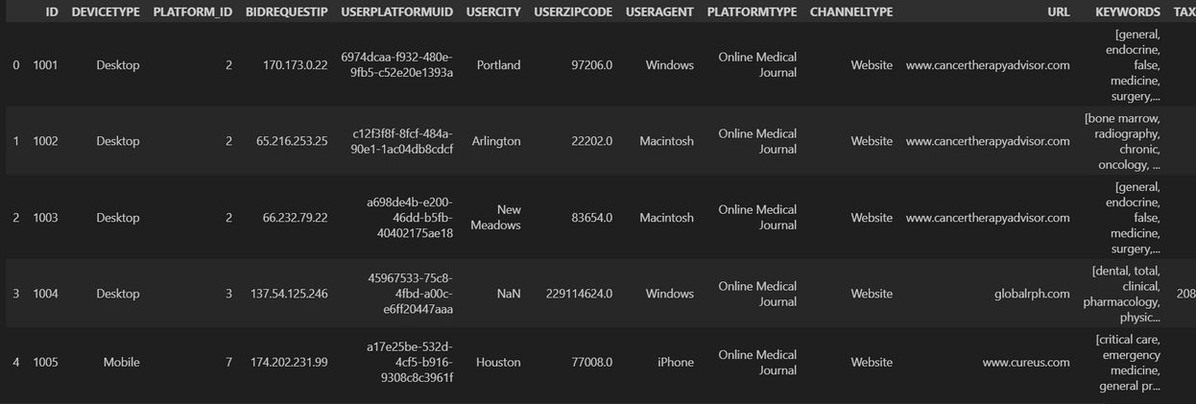
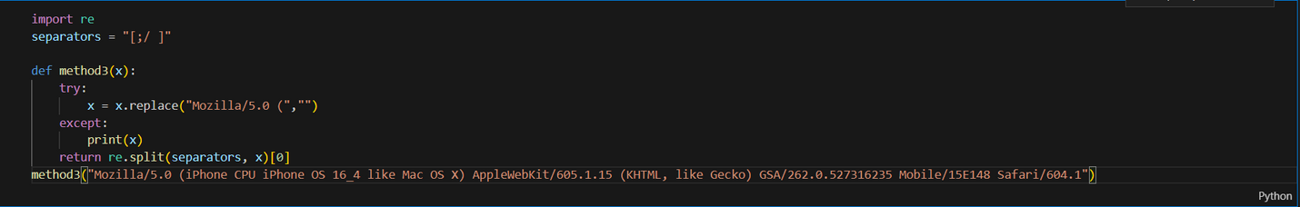
Execution Demo (Video/ Screenshots) of the solution:
Screenshots of the model

Slide 6
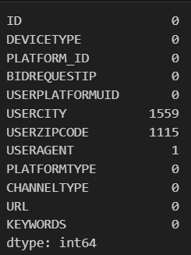
Execution Demo (Video/ Screenshots) of the solution:
Screenshots of the model

Slide 7
Source code in ZIP file/Github URL:
i
https://github.com/deshpanda/Identifying-Healthcare-Professionals--HCP-

Slide 8
THANK YOU!

